Slide 1
19CSE-461- NetCentric Programming
Dr.T.Senthil Kumar/Dr.S.Thangavelu/Dr.C.Arun Kumar

Slide 2
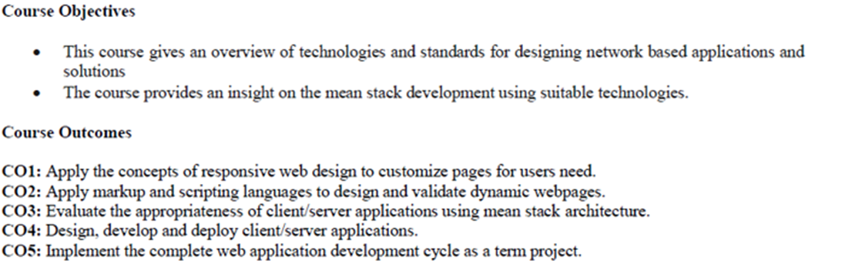
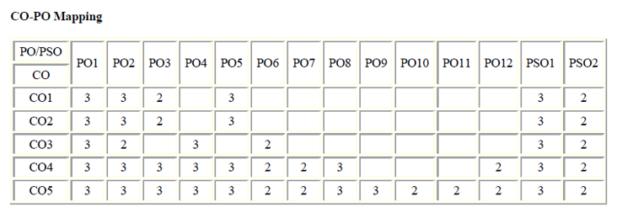

Slide 3
CO Modified
CO1 : Apply the concepts of responsive web design to customize pages for users need
CO2 : Apply markup and scripting languages to design and validate dynamic pages
CO3 : Evaluate Web Data representation with NoSQL data representation
CO4: Design, develop client/server applications
CO5 : Evaluate the appropriateness of client/server applications using Mean stack architecture
PO mapping is same as earlier approved in syllabus

Slide 4
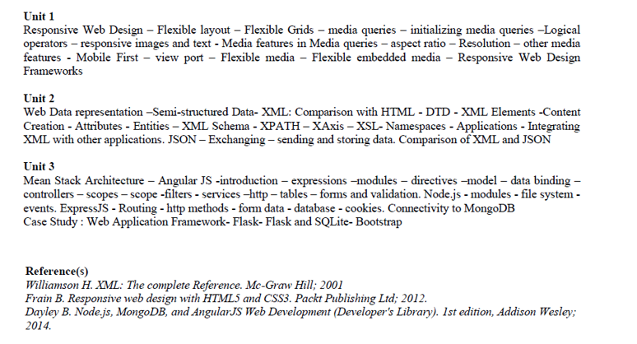

Slide 5
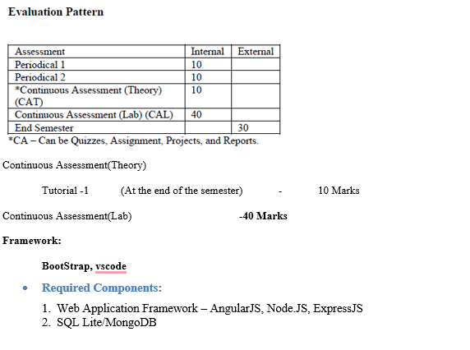

Slide 6
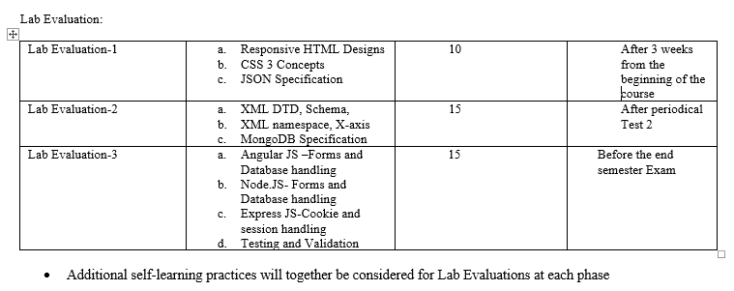

Slide 7
Fundamentals of Web Design
Purpose of Web Design
Inform/Educate
Persuade
Influences on Web Design
Technology Used by Both Target Audience and Designer
Nature of the Content
Economy (Budget, Time, and Scale of the Project)
Amount and Type of Visuals Included
Meeting Usability Objectives

Slide 8
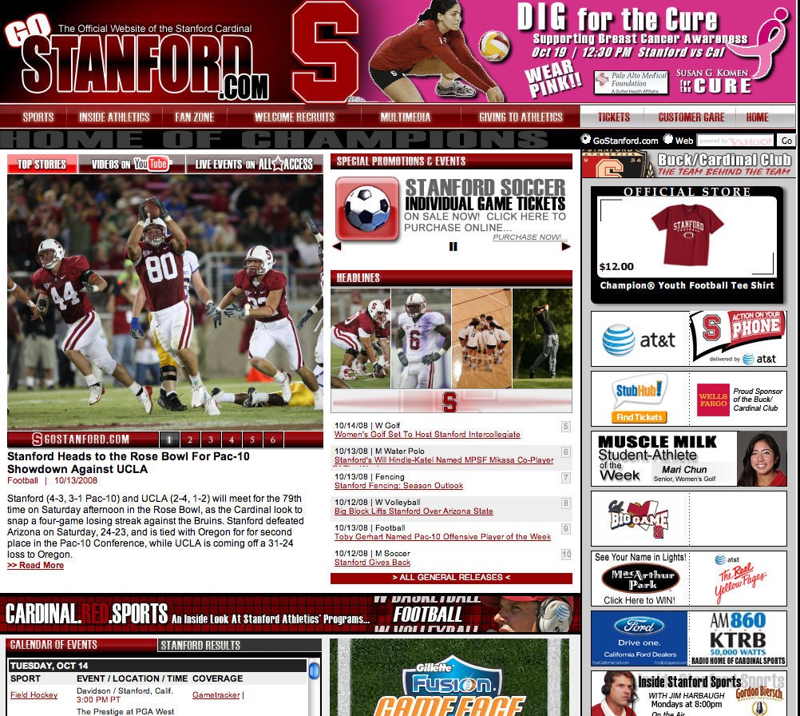
The Making of a Good Design
Content is important, but content alone will not make your site work.
Notes:
Biggest mistake in web design is to build a site for the designer, not the user.
Users expect sites to be flawless.
Looks matter. Site should be pleasing to the eye. Site should evoke trust and value.

Slide 9
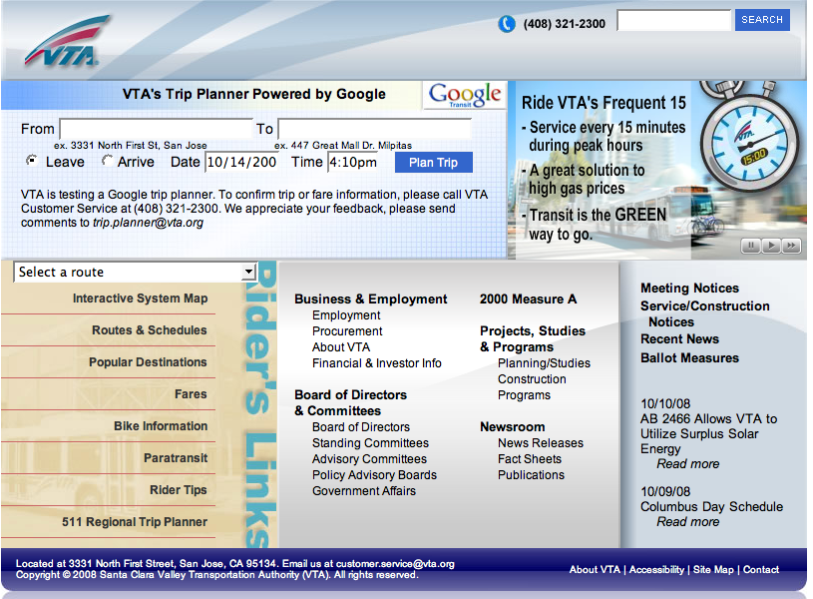
The Making of a Good Design
Content is important, but content alone will not make your site work.
Good Design is:
Understandable
Interesting
Easy to use
Uniform in look and feel
Done from a visitor’s point of view:
WYSIWYW (What You See Is What You WANT)
Notes:
Biggest mistake in web design is to build a site for the designer, not the user.
Users expect sites to be flawless.
Looks matter. Site should be pleasing to the eye. Site should evoke trust and value.

Slide 10
Good Design Maxims
“Rules” are only guidelines -- no single model fits every situation, and there is no such thing as the “right” way to create a web site.
Remember WYSIWYW
Web users want control over the online material -- they want to seamlessly obtain the information they need.
Don’t force visitors down a specific path -- give them control.

Slide 11
Typical Website Evolution
Generation 1 -- replaces paper information
Generation 2 -- has flashy elements
Generation 3 -- is bleeding edge, causing content to suffer
Generation 4 -- content and technology are integrated
Ideally, try to skip the problems of Generations 1-3 by planning your web site carefully.

Slide 12


General Methods for Design
“Ad-hoc” Process (“seat of the pants”)
Hastily put together
Created on the fly
“We need a web site TODAY”
A methodical, well-thought process includes:
Planning
Quality-assurance testing

Slide 13
Benefits of Ad-hoc Process
Sometimes “quick and dirty” is not only good enough, it’s the best way. It’s useable for:
Sites that will have a short lifespan
Very small web sites
Sites designed for a very specific purpose (a single survey, a single class, a specific event, etc.)

Slide 14
Pre-design Work
Consider your organization’s mission
Define the target audience
Set goals for the web site
Immediate
Long-term
Gather content
Organize and establish hierarchy of content
“Chunk” content into logical information units
Notes:
Start by looking at the big picture, then work down to the specifics.
1) define the problem/goal for the site
2) analyze the requirements
3) design a prototype; implement and test the site
4) show to clients; get feedback
5) develop new prototype
6) release and maintain the site
Forces developers to plan everything up front

Slide 15
More Pre-design Work
Create an outline or plan for content
Create your web site on paper first
Use a flowchart to depict how visitors will go from one page to another
Think about the actual HTML, PDF, graphic, sound, and other files you will need in the site
Where will they be placed?
How will visitors access them?
Organize the files logically, so that the development team can understand the hierarchy of the web pages.
Notes:
Site plan:
Goal statement
Audience assessment
Content requirements
Technical requirements
Visual requirements
Delivery requirements
Site structure diagram
Staffing requirements
Timeline for project
Budget estimate

Slide 16
Influences of Technology on Design
Browsers
Chrome, Mozilla are the dominant browsers
<http://www.w3schools.com/browsers/browsers_stats.asp>
<http://www.e-janco.com/browser.htm>
Operating systems
Windows 7 onwards is the most popular operating system(s)
Connection speeds
Depends on the client-side internet provider
User screen sizes
80% of users are using a display with 1024x768 pixels or more and a color depth of at least 65000 colors
<http://www.w3schools.com/browsers/browsers_stats.asp>

Slide 17
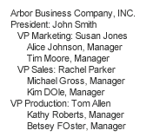
Visual items
Compare:

Slide 18
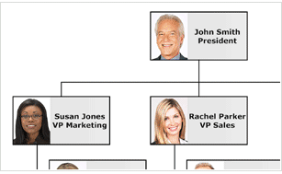
Visual items
Compare:

Slide 19
Usability -- User’s Memory
Don’t force visitors to remember how to navigate/use the site
Provide redundant, easily recognizable features
Generally, have visited and unvisited links be different colors to make it easy for users to remember where they’ve been
Limit the number of items in a group of choices

Slide 20
Usability -- Response Times
The amount of time a user will wait is proportional to the payoff. If they know there is something they want to see, they will wait for it.
Otherwise…
1 second: no major potential for interrupt
10 seconds: users become bored
More than 10 seconds: user may leave

Slide 21
Accessibility in Web Design
Make the navigation clear and simple
Use a clean visual layout with ample white space
Use descriptive link texts (avoid using “click here” without more information)
Provide text equivalents for non-text elements
Don’t rely solely on color to indicate links
Don’t make the screen flicker
Use plain, understandable English
Don’t rely completely on high-tech solutions
Use markup and style sheets -- HTML for structure and CSS for presentation. Don’t use visual markup (for example, to make text bold, use strong instead of b; to italicize, use em instead of i)
Don’t use header tags for visual formatting
Add "skip to" links to main navigation and page content
If PDF files are used, provide alternate formats for the information
Notes:
Best practices:
1) navigation is clear and consistent
2) clean visual layout & use of white space
3) CSS for visual formatting
4) Alt attributes for images
5) Header tags in their proper hierarchy (not for visual formatting)
6) flexible screen & font sizes
7) descriptive link text (not click here)
8) structural, not visual markup (strong not bold; em not i)
9) summary sentence at the top of each page
10) "skip to" links to main navigation and page content
11) PDFs - provide alternate formats
12) Audio/video - provide link to transcript

Slide 22
Maintenance/Improvement
Set a maintenance schedule for the site.
Who will do the maintenance?
What to do if emergency problems occur?
Where will backup copies of the site be located?
Schedule a quarterly review of the site.
Does the content need updating?
Is the design still working?
Are there newer, cutting-edge tools we should be using?

Slide 23
Resources - Web Sites
Web Style Guide A thorough and accessible guide to Web design http://www.webstyleguide.com/
Jacob Nielsen’s Use It A web site devoted to accessibility issues http://www.useit.com/
Cool HomePages.com A listing of the “coolest” home pages http://www.coolhomepages.com/
Vincent Flander’s Web Pages That Suck Learn good design by looking at poorly designed web sites http://www.webpagesthatsuck.com/
disABILITY Information and Resources A listing of web sites to help make web pages more accessible http://www.makoa.org/
Web Site Optimization Analyzer Analyze time it takes for web site to load http://www.websiteoptimization.com/services/analyze/
Web Browser Statistics http://www.w3schools.com/browsers/browserstats.asp
Lynx Viewer Emulations of lynx (text web browser) http://www.delorie.com/web/lynxview.html http://www.yellowpipe.com/yis/tools/lynx/lynx_viewer.php
WebTV Viewer An emulation of the WebTV browser http://developer.msntv.com/Tools/WebTVVwr.asp
HTML Validator Validates HTML code http://validator.w3.org/
Bobby Accessibility Validator Validates web sites for accessibility issues http://bobby.watchfire.com/
August 2005 Connection Speed Statistics: http://www.websiteoptimization.com/bw/0508/
World Wide Web Consortium The organization responsible for creating official web standards http://www.w3c.org/
W3Schools Online web tutorials (also contains web statistics) http://www.w3schools.com/

Slide 24
Resources - Books
HTML & XHTML: The Complete Reference
Author: Thomas Powell
ISBN: 0-07-222942-X
Web Design: The Complete Reference
Author: Thomas Powell
ISBN: 0-07-222442-8
Designing With Web Standards
Author: Jeffrey Zeldman
ISBN: 0-73-571201-8
HTML for the World Wide Web
Author: Elizabeth Castro
ISBN: 0-32-113007-3
Integrated Web Design
Author: Molly Holzschlag
ISBN: 0-73-571233-6

Slide 25
References
https://web.stanford.edu/group/csp/cs21/webdesign.ppt
https://www.geeksforgeeks.org/html5-introduction/

Slide 26
Web technology Stack
What Is A Web Development Stack?
A tech stack is defined as the set of technologies an organization uses to build a web or mobile application. It is a combination of programming languages, frameworks, libraries, patterns, servers, UI/UX solutions, software, and tools used by its developers.
Besides, A stack can (and is meant to) be used repeatedly to develop web applications. Individual developers, as well as software companies, often specialize in a specific stack or several stacks.
As a potential client of a software company or someone interested in developing a new web or mobile app, you should definitely be interested in the web development stack of the company you wish to work with.
It refers to the technologies they specialize in and use together to develop new pieces of software. They mainly consist of NodeJS, MongoDB, ExpressJS, Angular, React, Vue, PostgreSQL, MySQL, Apache.

Slide 27
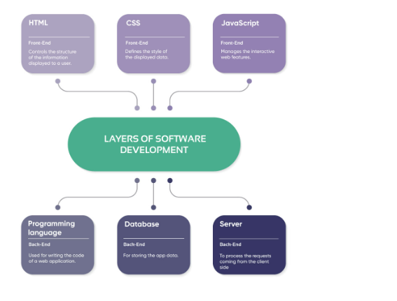

Slide 28
Front End/Client Side Technology stack
A web application has two primary sides. One is available to the client and is accountable for the UI, while the other is liable for the client’s experience.
The side which is open to the client and exploited by him/her to communicate with the application establishes the front end. The front-end technology stack principally comprises HTML, CSS, Java, and so forth.

Slide 29
HTML
It is a programming language utilized for portraying the construction of data introduced on a page.
Also, it utilizes the most recent rendition of HTML HTML5 which has new components and qualities for making web applications all the more effective and viably.
The fundamental benefit that HTML5 is that it has sound and video support, which was excluded from past variants of HTML.

Slide 30
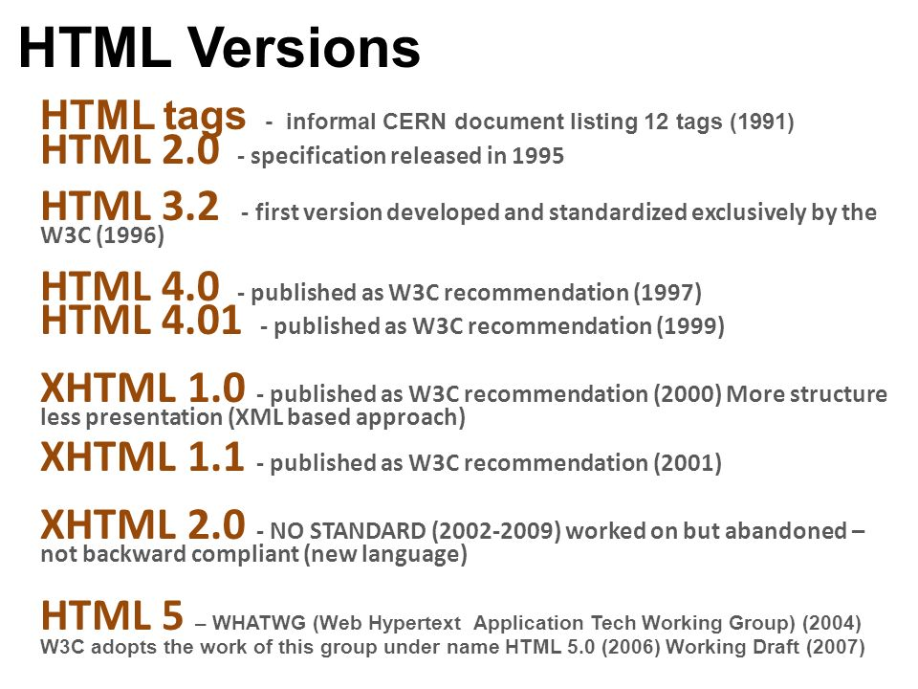

Slide 31
CSS
CSS
It is a template language that portrays the look and design of a document written in HTML. CSS is utilized for explaining text and insert labels in styled electronic documents.

Slide 32
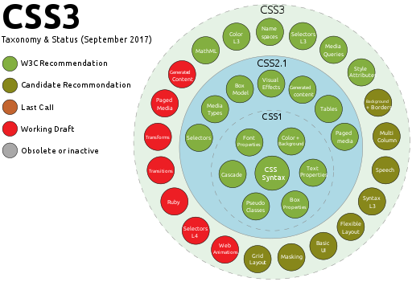

Slide 33
javaScript
It is the third primary technology for building the front end of a web application.
It is regularly utilized for making dynamic and intuitive site pages.
Besides, it also empowers basic and complex web animations, which significantly add to a positive client experience. JavaScript helps to make easy-to-understand applications for addition on this subject.

Slide 34
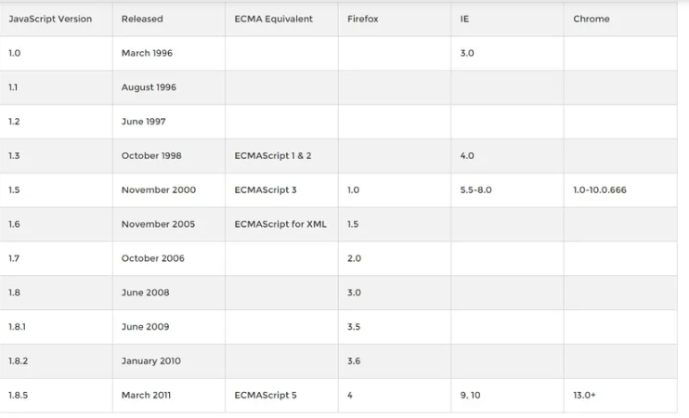
* 12 versions of Java script exist, 1.4 is not in list as it is designed for Netscape browser ,ECMA script implements JavaScript, JScript, and ActionScript

Slide 35
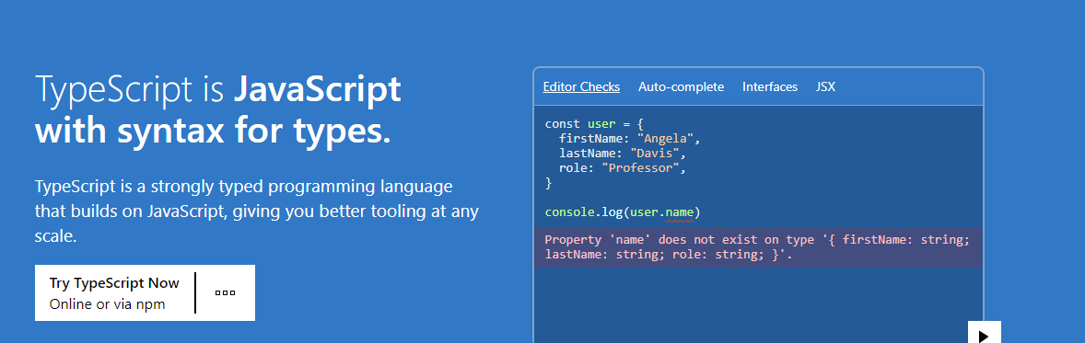
TypeScript

Slide 36
Back-End, Server-Side Technology Stack
The working of the application dependent on the client association is primarily the back end or server-side.
It isn’t available to the client, and the technology answerable for creating it is known as the back-end technology stack.
Programming languages, libraries, structures, servers, data set administration frameworks, and so forth, are the huge parts of back-end tech stacks.

Slide 37
Back End Components
Programming languages – This makes logic for applications and sites. The codes interface the web to a data set. A few models are JavaScript, PHP, and Python.
Frameworks – it offers help for applications dependent on a single programming language. Laravel, Django, and Ruby on Rails are many of the well-known systems.
Web Servers – You need backend servers to oversee customer demands. Apache, Nginx, and Microsoft’s Internet Information Server (IIS) are extraordinary instances of web servers.

Slide 38
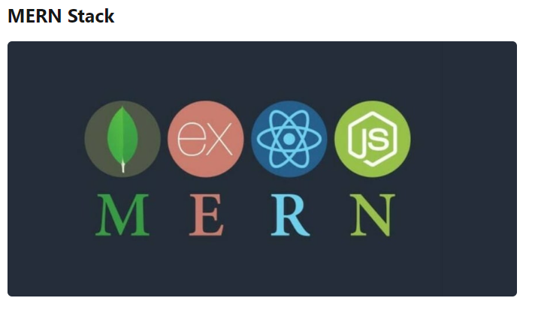
MERN is one of several variations of the MEAN stack (MongoDB Express Angular Node), where the traditional Angular frontend framework is replaced with React JS.
The main benefit of using MERN is the integration of React and its powerful library and capability to use code simultaneously on servers and browsers.
Additionally, it has phenomenal full-stack development (front-end and backend) possibilities. Besides, React utilizes JavaScript XML and Virtual DOM, and these components work and implement changes seamlessly.

Slide 39
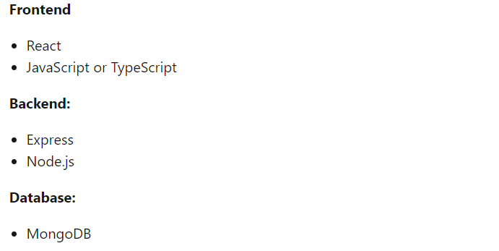

Slide 40
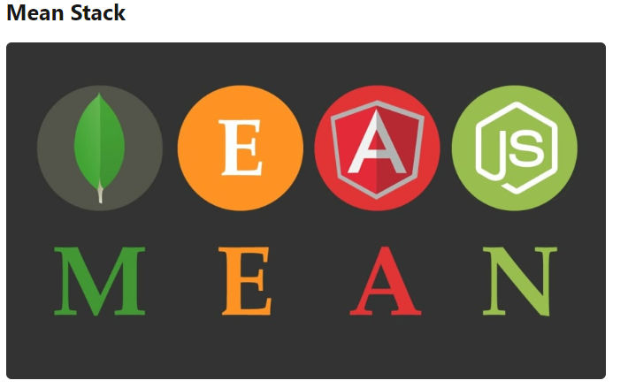

Slide 41
MEAN is a free and open-source JavaScript software stack for building dynamic websites and web applications.
Because all components of the MEAN stack support programs are written in JavaScript.
Besides, experts consider MEAN technology the best for web development due to its various benefits.
It’s comprised of MongoDB (a NoSQL DB), Express.js (a backend web framework), Angular (a front-end framework), and Node.js (an open-source cross-platform server), and can be used for developing complex mobile and responsive web applications.
The single language used throughout this stack is JavaScript. Its components are JSON savvy and excellent in data transmission with free module library access. This means web developers can reuse this code across the whole app without reinventing the wheel.

Slide 42
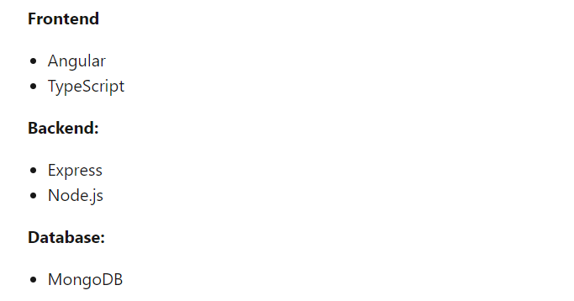

Slide 43
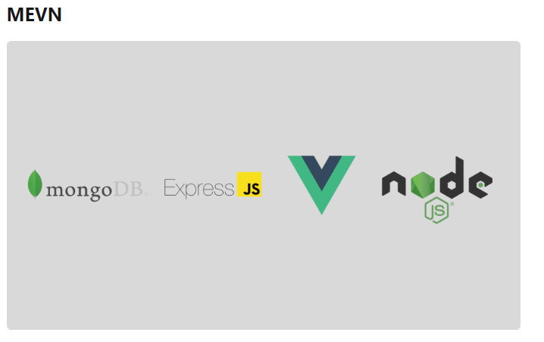

Slide 44
Other variants of MEAN Stack, the MEVN Stack (MongoDB, Express, Vue, Node), and really any frontend JavaScript framework can work.
It is the open-source JavaScript software stack that has emerged as a new and evolving way to build powerful and dynamic web applications.
Besides, its software components can be used to effectively design frontend and backend development and improve the functionality of your website or app.

Slide 45
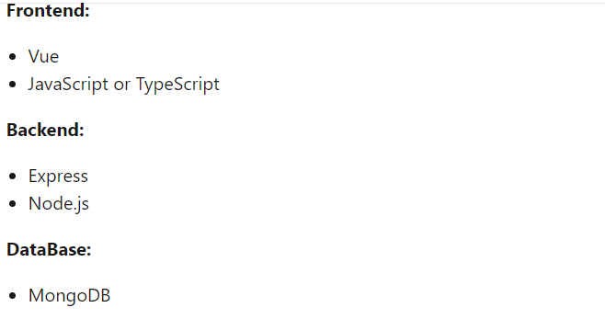

Slide 46
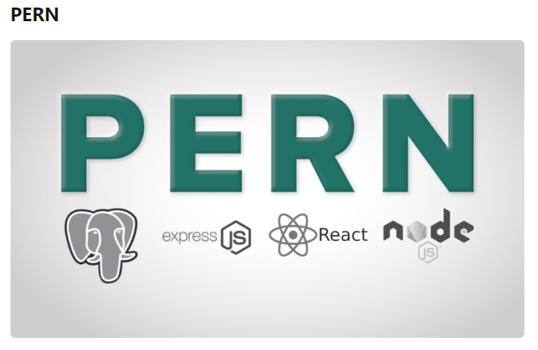

Slide 47
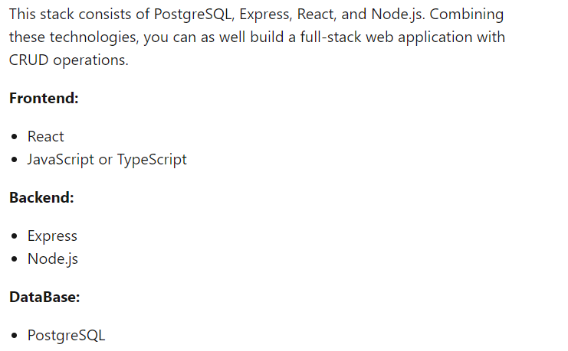

Slide 48
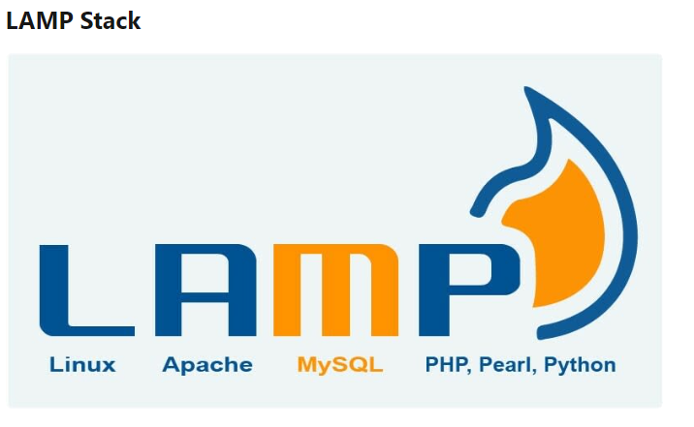

Slide 49
LAMP is an old classic industry standard when it comes to time-tested web development stacks, which comprises MySQL (Relational Database Management), Linux (Operating System), PHP (Programming Language), and Apache (HTTP server). It is open-source and available for free.
The stack runs efficiently on all operating systems. In web development, it provides the website with the best performance, cost efficiency, and flexibility.
Besides, its components can be interchanged or modified within the same stack. LAMP refers now to a generic software stack model and its components are largely interchangeable.

Slide 50
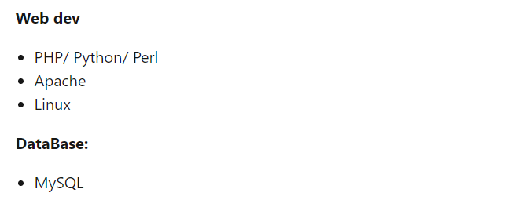

Slide 51
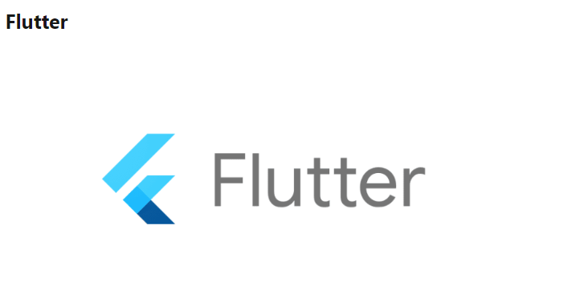

Slide 52
Flutter is an open-source software development program for developing Android, iOS, Mac, Windows, Web, and Linux applications from a single codebase.
With it, you don’t have to compromise on speed while building user interfaces, adding new features, or fixing bugs.
Besides, it is essential to employ a steady software technology stack when making software or an application
. The backend needs to be created with tools that complement each other to reduce development time and coordinate resources.
Advantages:
Dart.
High performance.
Growing popularity.
Mild learning curve.
One UI design.

Slide 53
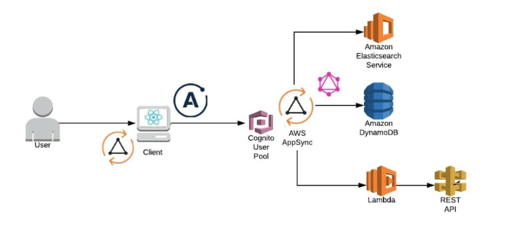
Serverless technology stack, one can easily scale up to thousands of users immediately during sudden spikes, and scale down, too, as the spike subsides.

Slide 54


Slide 55
Ruby on Rails (RoR) is a developer-friendly web development stack. It is an open-source, dynamic programming language.
Besides, RoR facilitates the development of lightweight applications that increase flexibility.
Furthermore, the stack works in tandem with HTML, CSS, and JavaScript for creating interactive user interfaces, and XML or JSON for data transfer.
Also, it allows the use of default structures for web pages and database management. It also provides developers with a detailed error log to build bug-free applications.

Slide 56
Full Stack Developer
Who is a Full Stack Developer?
A Full Stack Web developer is an expert who has the knowledge and understanding of both sides of development; the front-end and back-end programming.
The developer has a wide area of knowledge with the ability to create a complete web application. However, the most significant part is s/he understands the boundaries between each of the varied roles they perform.
The name ‘full-stack’ justifies itself as a full stack developer should have the understanding of all the layers in any of the stack preferred by the developer like The MEAN Stack, The MERN Stack, The LAMP Stack.
Front -End: Also known as the client-side of the web application that the user interacts with. The developer will focus on the coding for the user interface.
Back-end: Server-side or back-end of the web application is everything that goes behind the scenes. A back-end developer is responsible for the base functioning of an application or website.
Database: The database is a place to store the data for any of your project or application you are working on. Some popular databases are MYSQL, Oracle, SQL Server, etc.
DevOps: It is a methodology wherein the gap between the development and operations team is bridged. They work together as a team to deliver faster, reliable, and better results while creating an application.

Slide 57
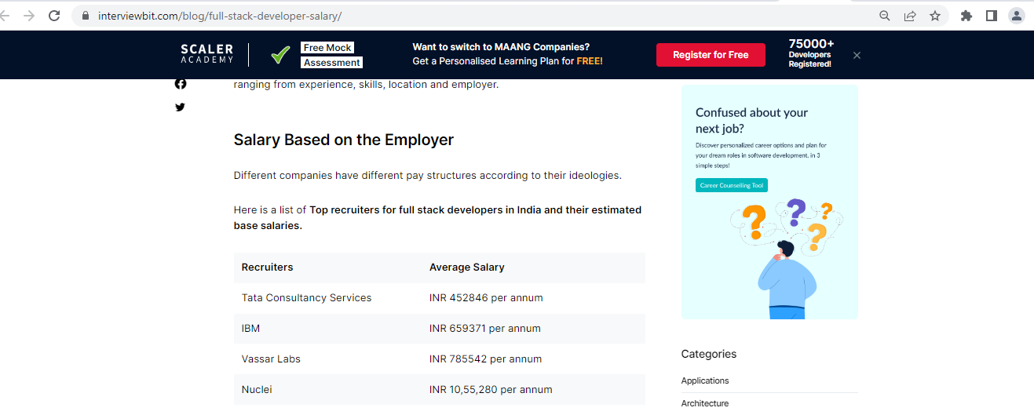

Slide 58
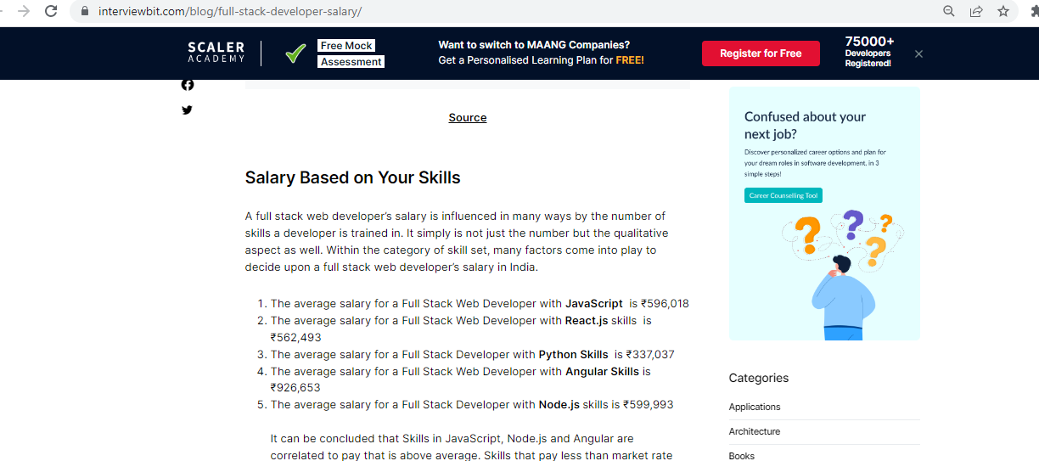

Slide 59
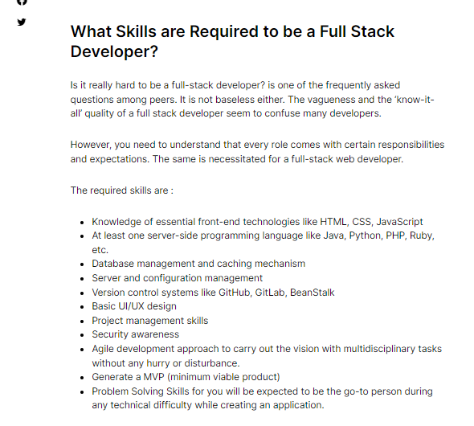
Source: https://www.interviewbit.com/blog/php-developer-salary/

Slide 60
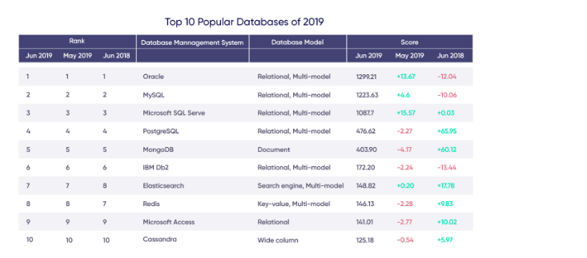

Slide 61
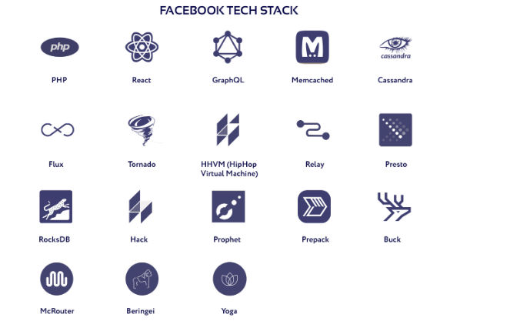

Slide 62
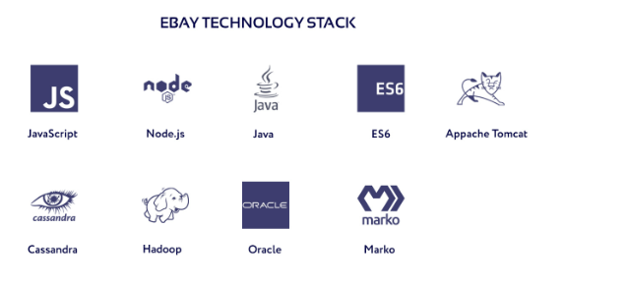

Slide 63
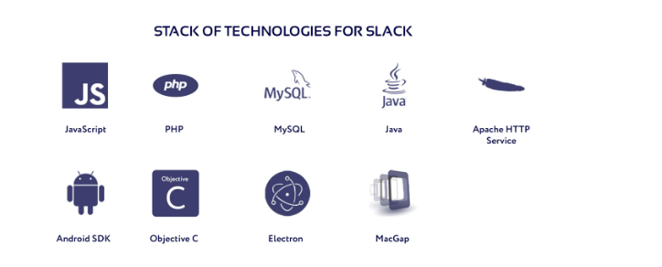

Slide 64
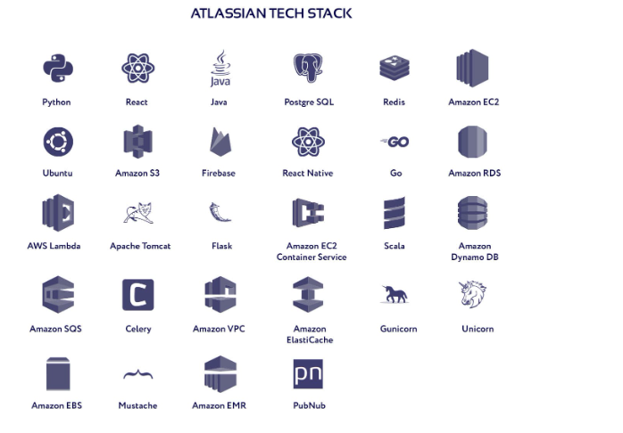

Slide 65
References
https://www.delftstack.com/howto/javascript/javascript-version/
https://light-it.net/blog/choosing-a-technology-stack-for-web-application-development/
https://light-it.net/blog/choosing-a-technology-stack-for-web-application-development/

Slide 66
Session -2 Plan
Responsive web design concepts
Creating a responsive web design with HTML 5 and CSS
* Students will be shared with manual for deploying the components for mean stack development at each phase

